Slide 1
About Me
Praful Surjuse

Slide 2
Early 15 years
Early Life
Born and grow in small town Narkhed (Near Nagpur) India
Father – Shop owner Mother- Housewife
1 younger sister 1 elder brother
Completed Junior Highschool from
Nagar Parishad Highschool , Narkhed

Slide 3
Education
Completed Senior Highschool from Hadas Highschool, Nagpur
Completed Bachelors Electrical Engineering from VJTI Mumbai University
Completed Masters Electrical Power Systems from VJTI Mumbai University based on GATE exam
Got selected for internship at Tata Power , Mumbai
Got interested in Computer Programming.
Joined NIIT to learn OOPS, Java/J2EE. Got placed to start my IT career at Capgemini, Mumbai in January 2007.

Slide 4
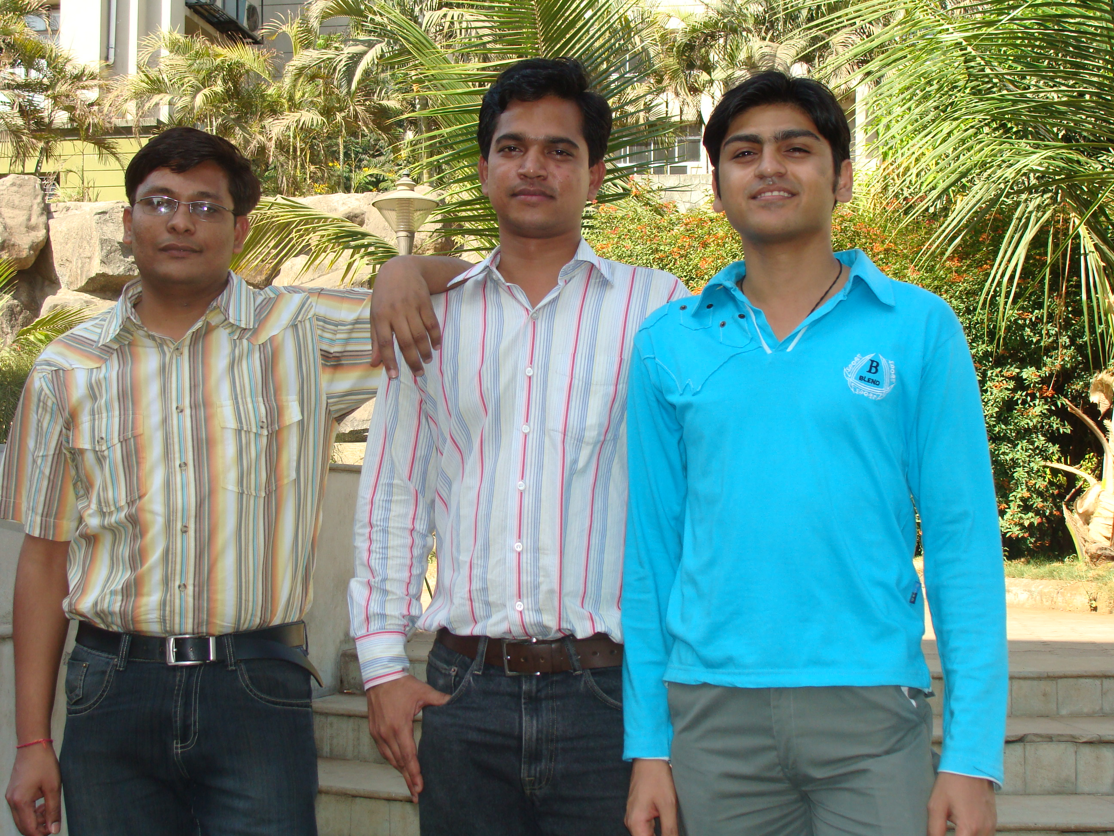
New Career in IT at Mumbai
At Capgemini,
Initially worked on internal java projects as recession was started.
Worked on TDC project, where I learned to interact with client and working on enterprise java applications.
November 2009, joined ATOS , worked on java project for client Wingas Transport

Slide 5
Career in IT at IBM, Pune, India
Moved to IBM , Pune in Oct 2010.
Worked on Telus, Canada project, where I worked on various enterprise java applications.
February 2012, IBM has trained us on IBM BPM Lombardi edition 7.5.
Worked on Barclays project at Radbroke Hall UK for 1 year
as IBM BPM Developer

Slide 6
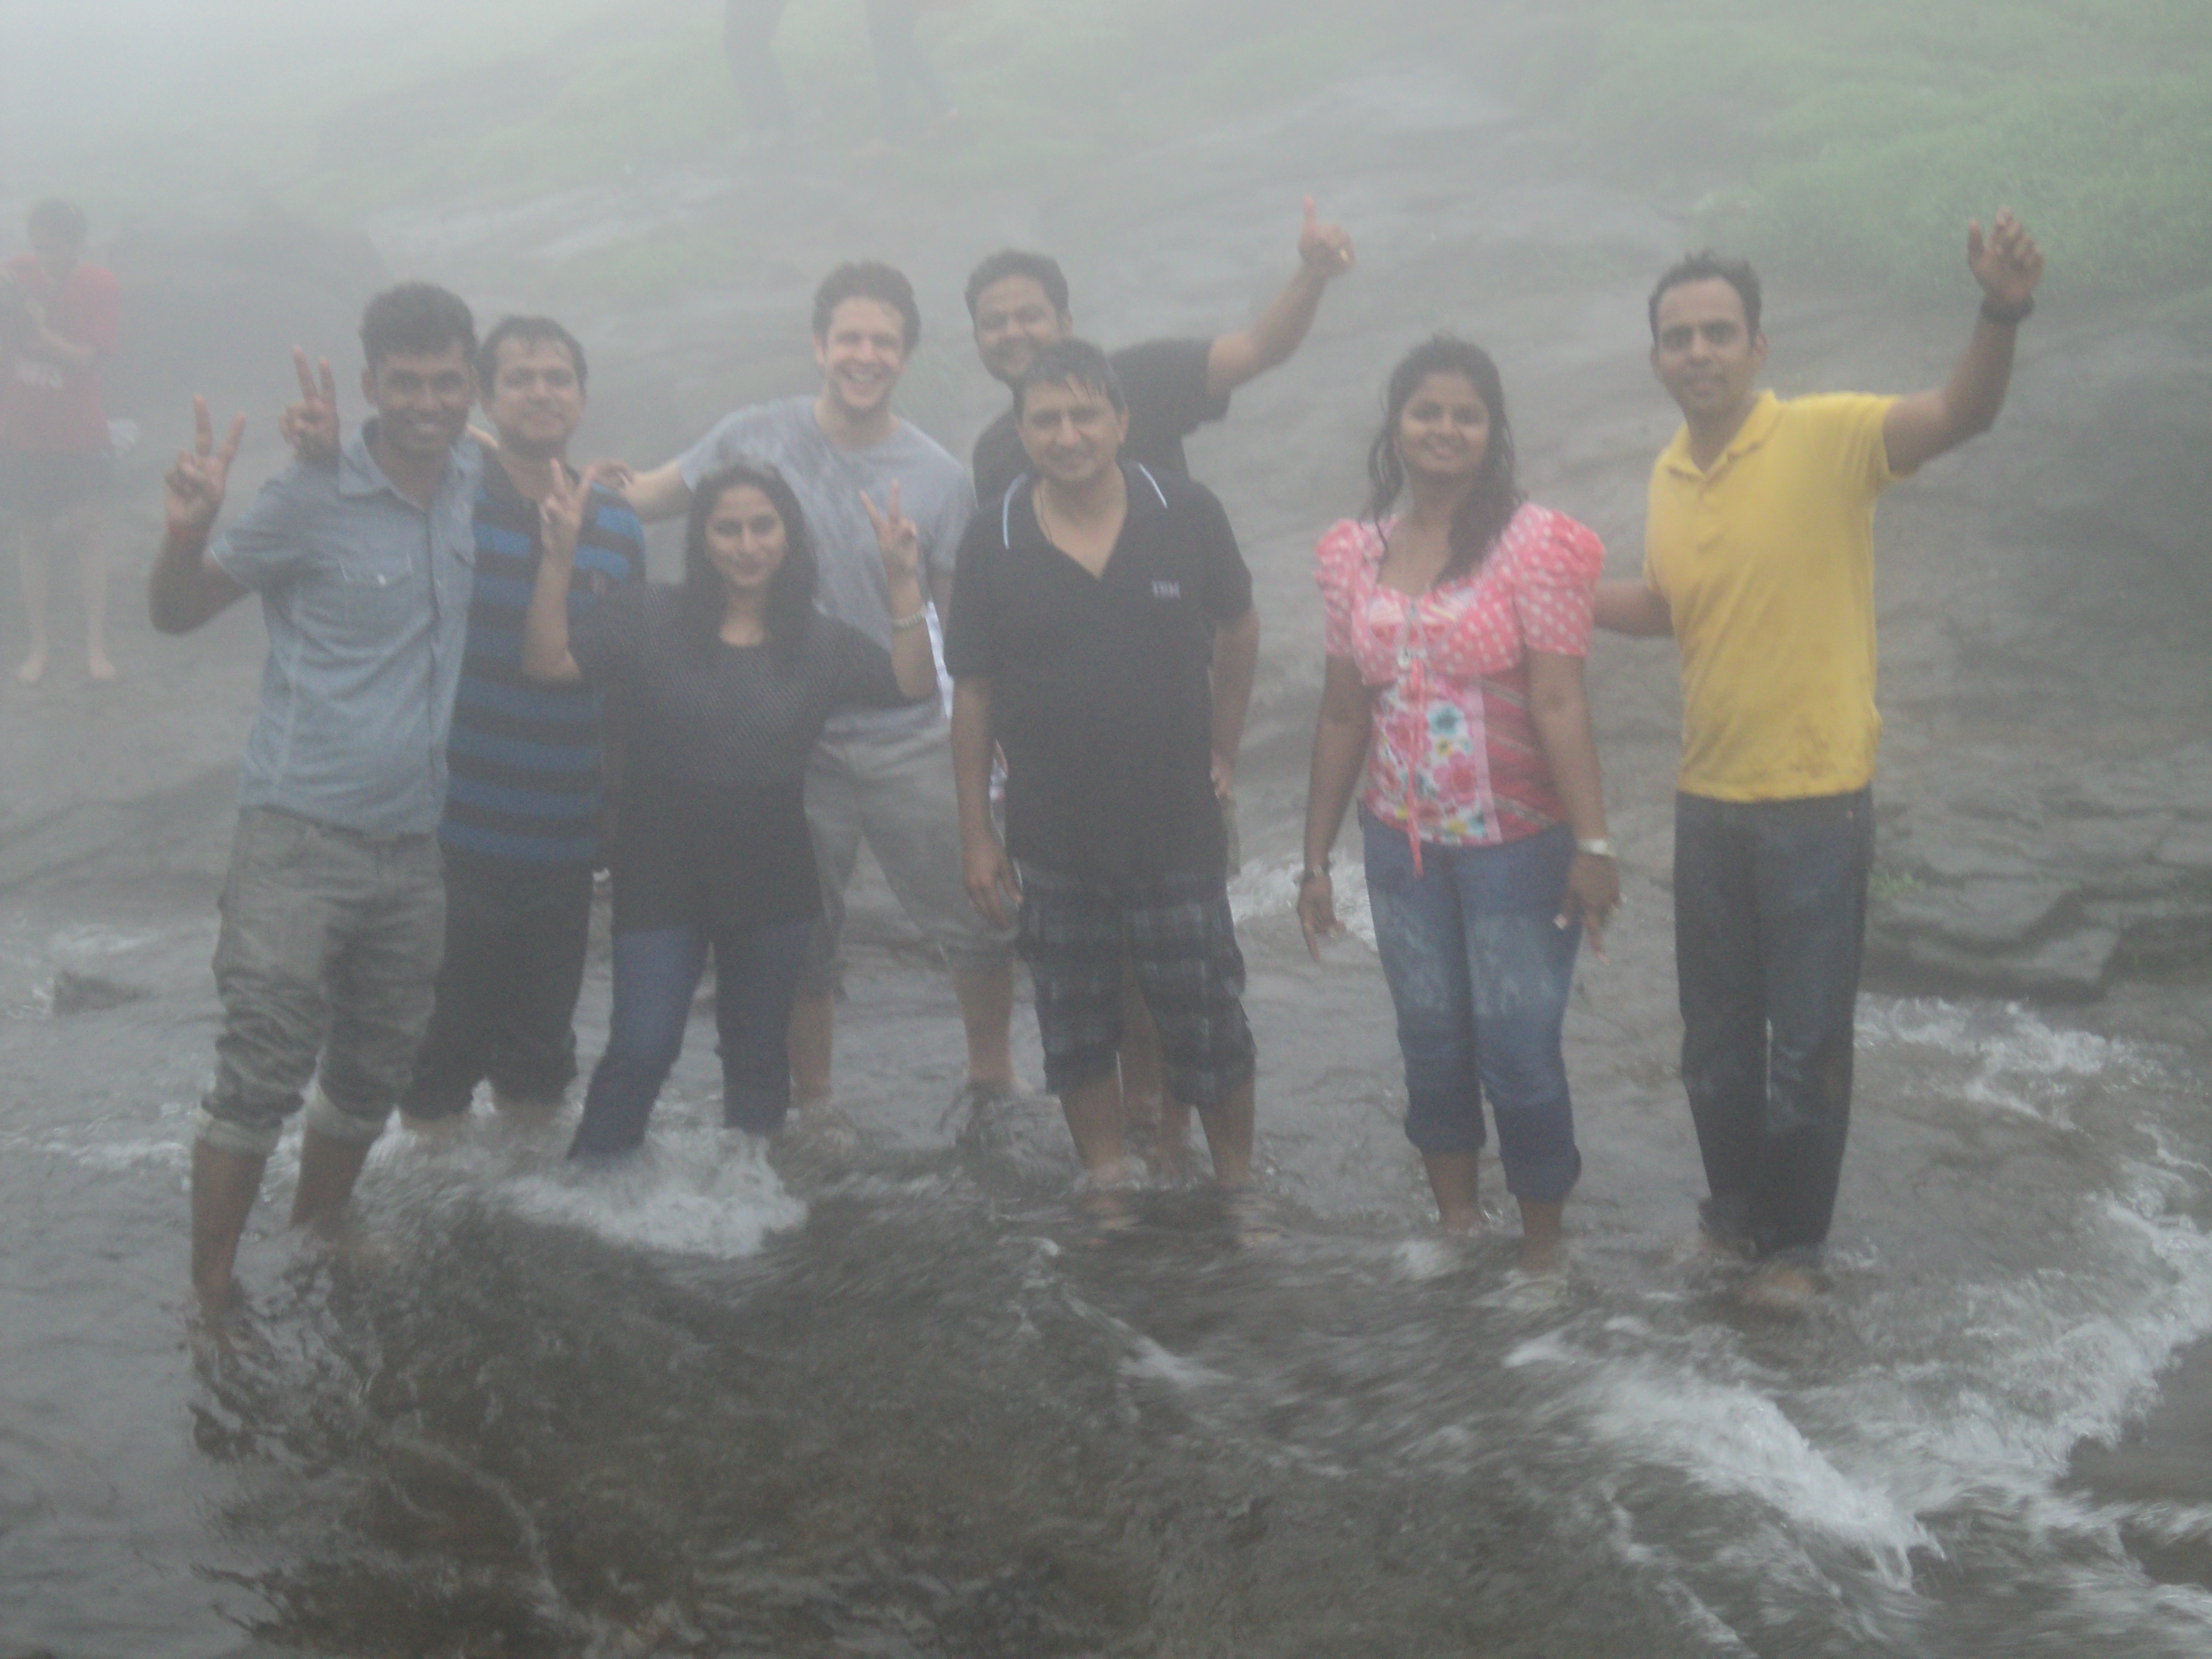
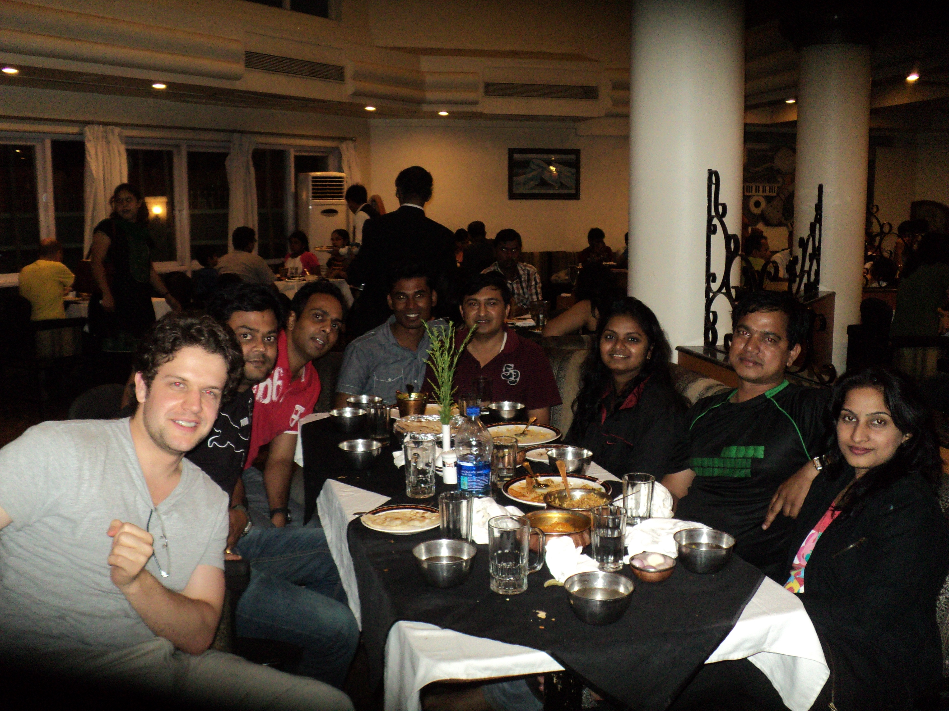
Barclays Team at IBM Pune

Slide 7
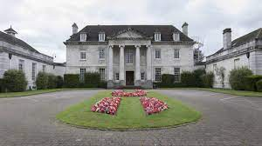
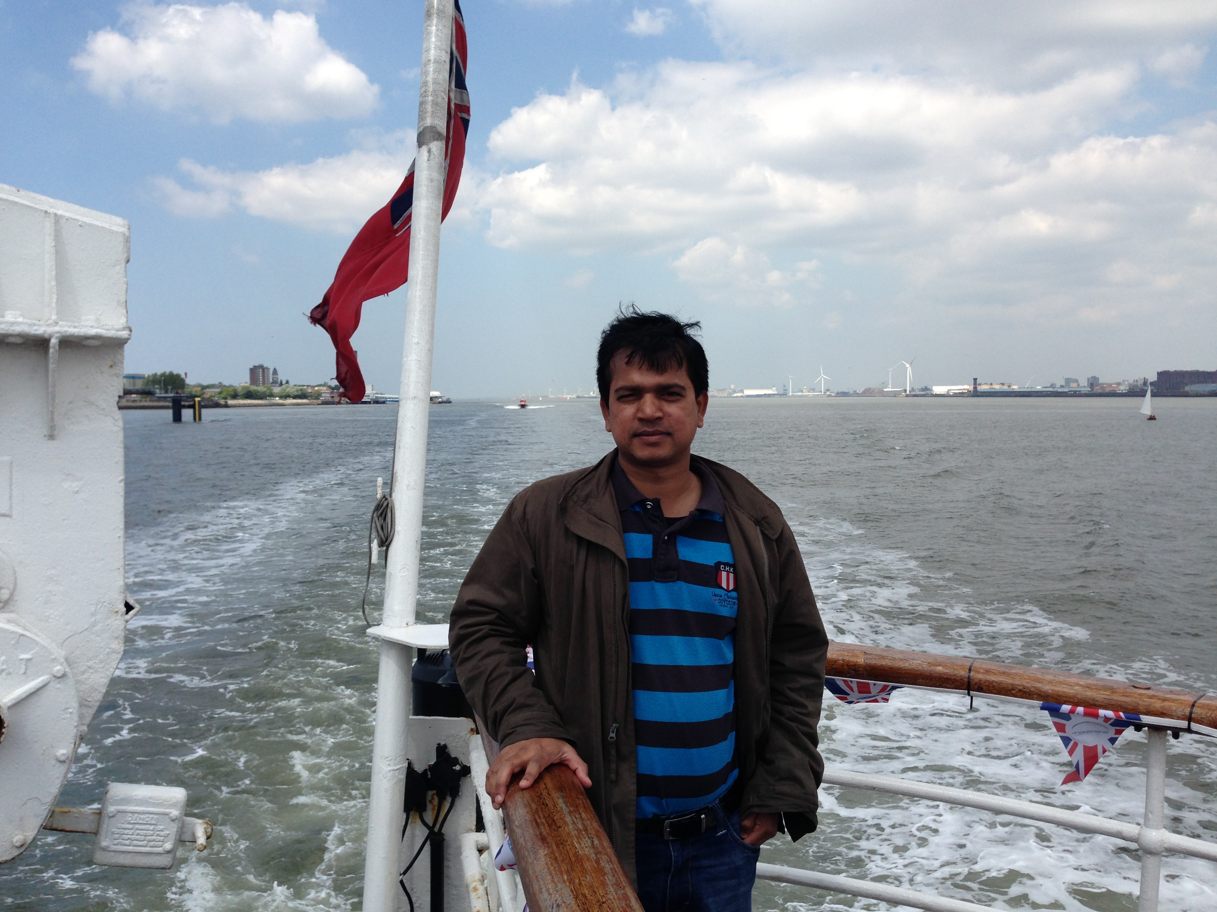
Radbroke Hall, Knutsfurd, Cheshire, UK
Me at Liverpool, UK

